Slide 1



Operation STOR-i Time(tabling)
Our entry to IHTC-2024
Presented by Matthew Davison

Slide 2






The team!
Matthew Davison
Graham Burgess
Rebecca Hamm
Ben Lowery
Adam Page

Slide 3
The IHTC-2024 elements
What are the decisions that need to be made?
Patients
Admission day
Operating theatre
Recovery room
Nurses
Shifts worked
Rooms covered on each shift
What was given to us?
30 problem instances, 10 test instances
C++ source code for tool that evaluates solutions

Slide 4
The IHTC-2024 constraints
What constraints does the problem have?
Hard constraints: RoomGenderMix, PatientRoomCompatibility, SurgeonOvertime, OperatingTheaterOvertime, MandatoryUnscheduledPatients, AdmissionDay, RoomCapacity, NursePresence, UncoveredRoom
Soft constraints: RoomAgeMix, RoomSkillLevel, ContinuityOfCare, ExcessiveNurseWorkload, OpenOperatingTheater, SurgeonTransfer, PatientDelay, ElectiveUnscheduledPatients
What constraints does the solver have?
Maximum of 10 minutes of wall-time
Maximum of 4 cores for processing
Maximum of 64GB of RAM

Slide 5
Initial feasible solution generation
Ignore all non-mandatory patients and create patient list of patients ordered by EAD*
Create list of unscheduled patients ordered by EAD*
Calculate workloads of rooms for each shift
Create list of admitted patients ordered by admission day
Iterate over days:
Iterate over shifts:
Iterate over nurses:
Iterate over days:
Iterate over patient list:
Join lists together to create new patient list:
Patient p admitted already?
Can nurse n cover shift?
Y
N
N
Y
Skip p
Unscheduled patient list
Skip n
Try to admit patient p on day d
Admitted patient list
Does n have capacity?
N
Y
No
Skip n
Are all the mandatory patients admitted?
Time limit check
Assign nurse to shift
Yes
*EAD: Earliest Admission Day
Out of time, no solution!
Initial solution!

Slide 6
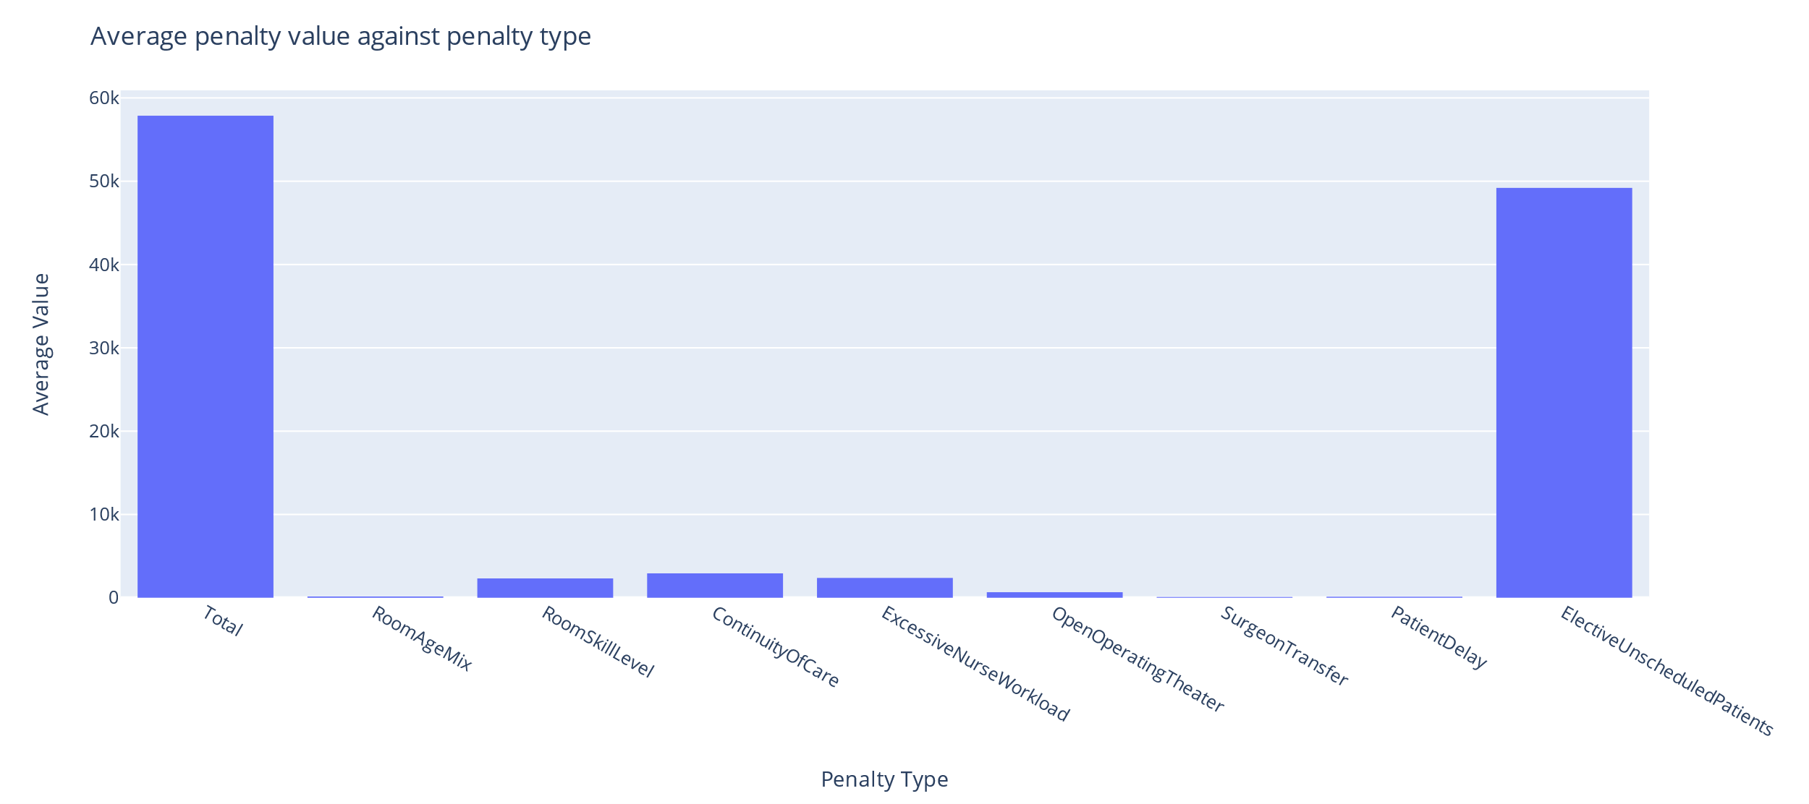
Average penalties of initial solutions

Slide 7
What base changes can we make?
Problem: Many unscheduled non-mandatory patients
Solution: Can take existing schedule and add unscheduled patients into it
Insert patient
Insert patient based on room capacity
Insert patient based on surgeon availability
Add a nurse into a room
Problem: The current arrangement doesn’t allow more to be added
Solution: Remove patients to create spaces in the schedule
Remove a non-mandatory patient
Remove any patient
Remove a nurse from a room

Slide 8
Sequential changes
Problem: Removing nurses and patients worsens objective value
Solution 1: Accept the dip in quality for now as this may help us escape local optima (keep in mind for later…)
Solution 2: Perform another operator (or operators) in the same iteration to try and rectify the situation immediately
Remove a non-mandatory patient and try to insert an unscheduled patient
Remove a nurse from a room and place them into a different room
Compounding operators is a way of generating new operators!

Slide 9
Improvement procedure
Distribute solutions to cores for augmentation
Choose operator(s) for Sol 1
Evaluate
Choose solutions to keep based on acceptance scheme
Choose operator(s) for Sol n
Evaluate
Initial solutions
Generate a pool of solutions using existing solutions
Time limit check
Solutions
New solutions
Final solution!
Best solution

Slide 10
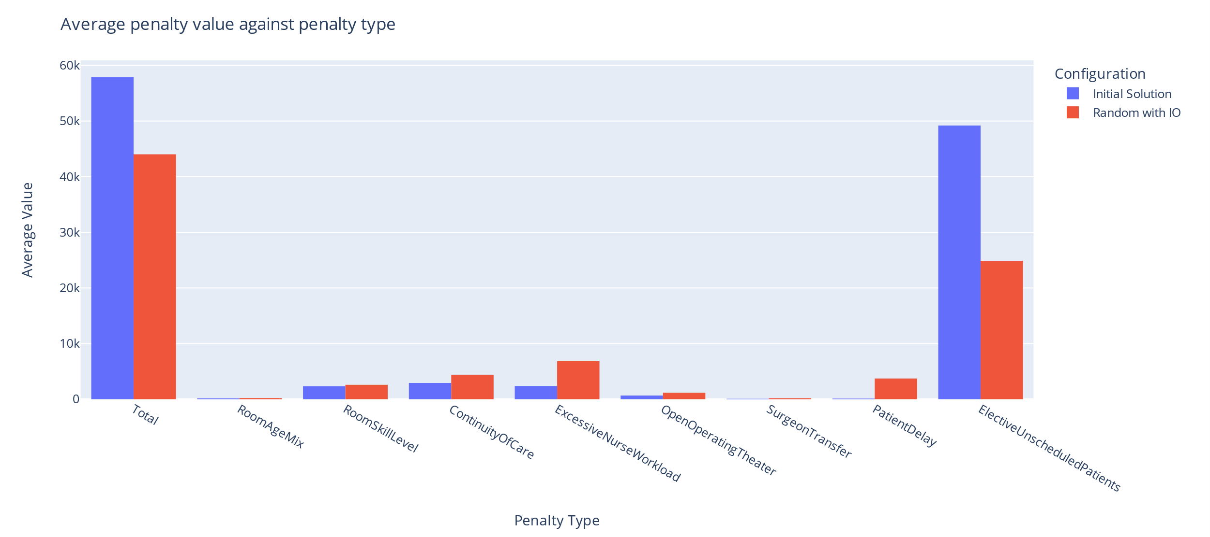
Random selection, improving only

Slide 11
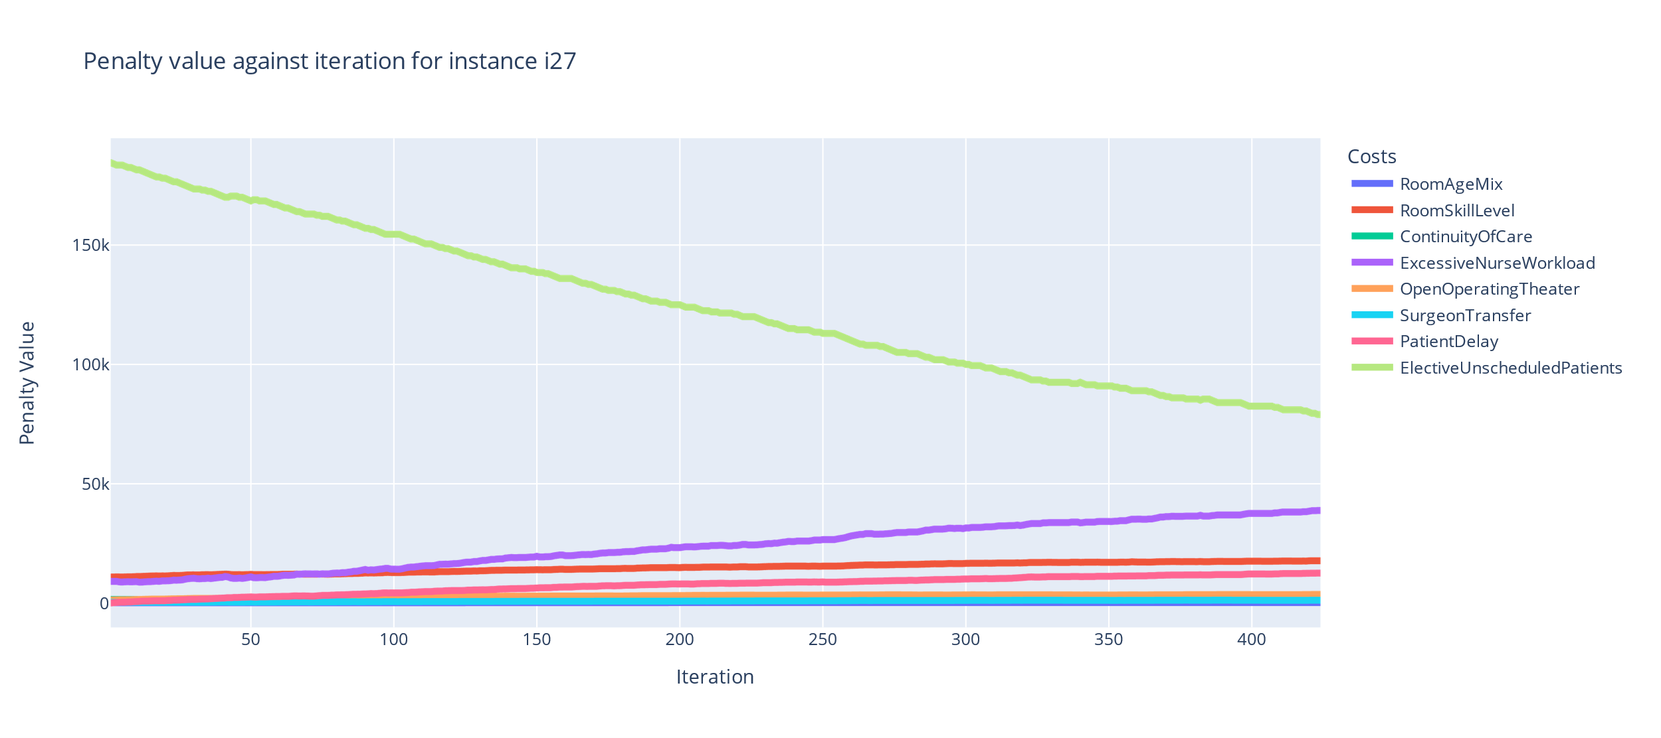
Random selection, improving only (i27)

Slide 12
Acceptance of changes
Problem: Removing nurses and patients worsens objective value
Solution 1: Accept the dip in quality for now as this may help us escape local optima
Problem: When do we decide when to accept worsening solution?
Record-to-record: Accept a solution if it falls within a certain threshold of the best solution (deterministic).
Simulated annealing: Accept a solution based on a p-value determined by previous penalties and remaining time (stochastic).

Slide 13
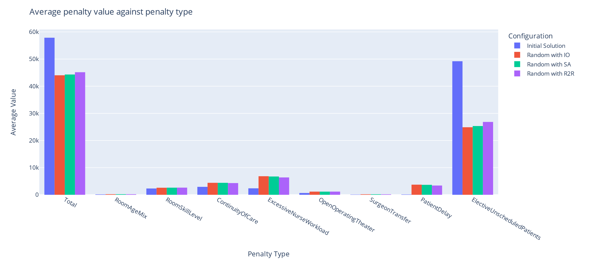
Random selection, comparing acceptance

Slide 14
Operator sequence selection
Problem: Random selection uses only pre-defined operators and may waste time on selecting bad operators
Select sequences of operators to automatically generate new operators
Use the success/failure of operator sequences to influence the choice of operator in future iterations
Monte-carlo reinforcement learning (MCRL): Chooses a sequence of operators, applies sequence, and evaluates the sequence. Generate future sequences based on policies.
Q-learning: Starts a sequence, chooses one operator to add to sequence, evaluates sequence and decides whether to add another. Generates sequences based on recently used operators.

Slide 15
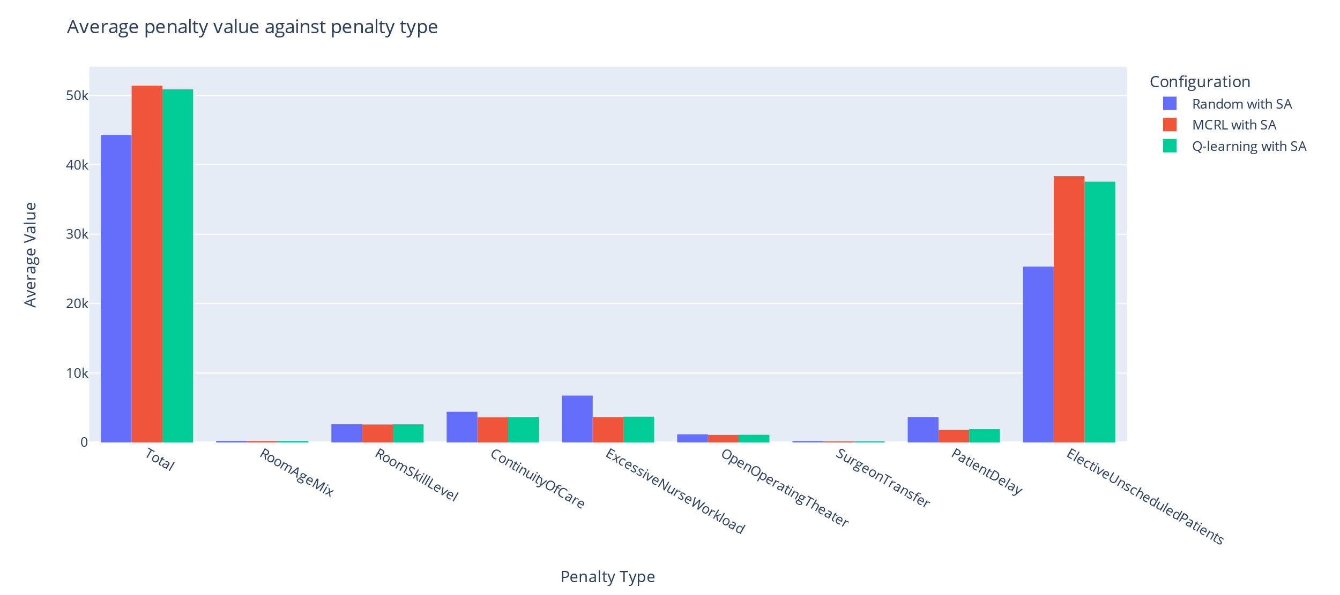
Smart selection, simulated annealing

Slide 16
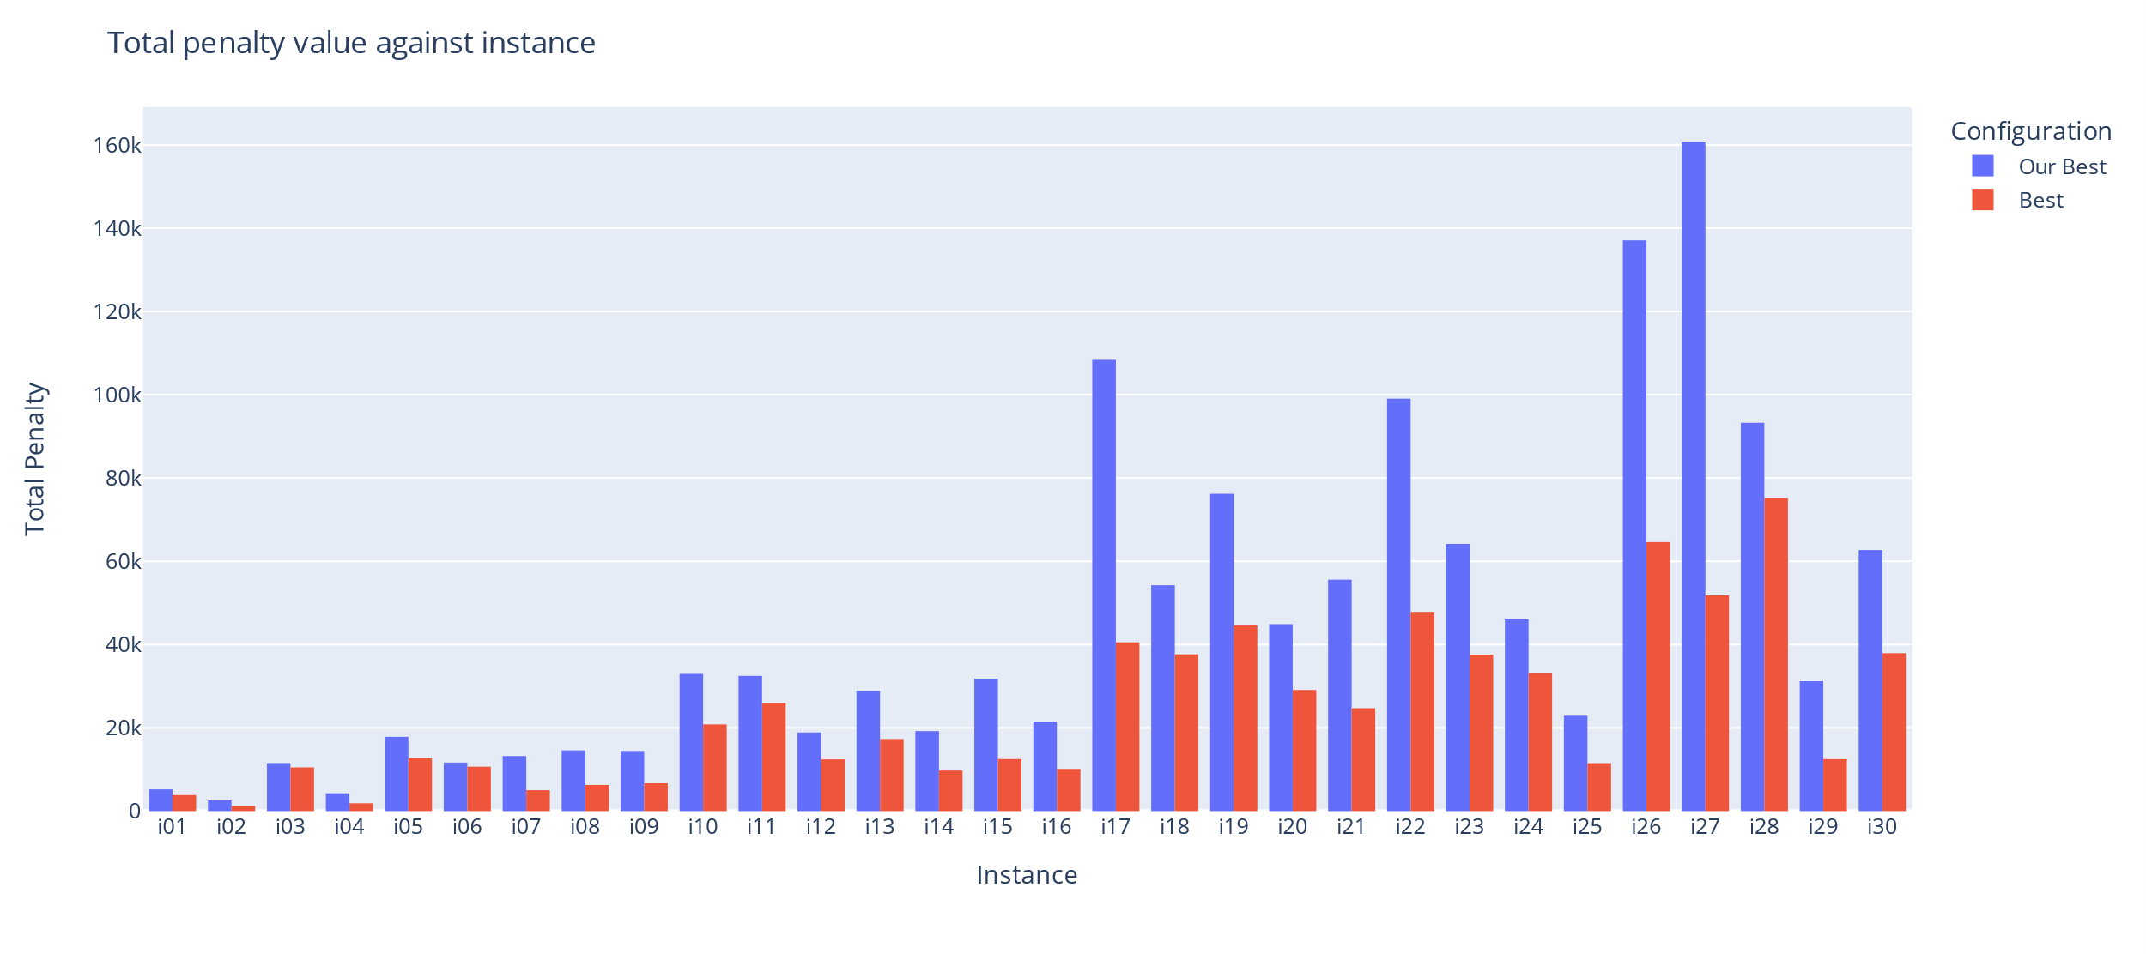
Comparison with best available

Slide 17
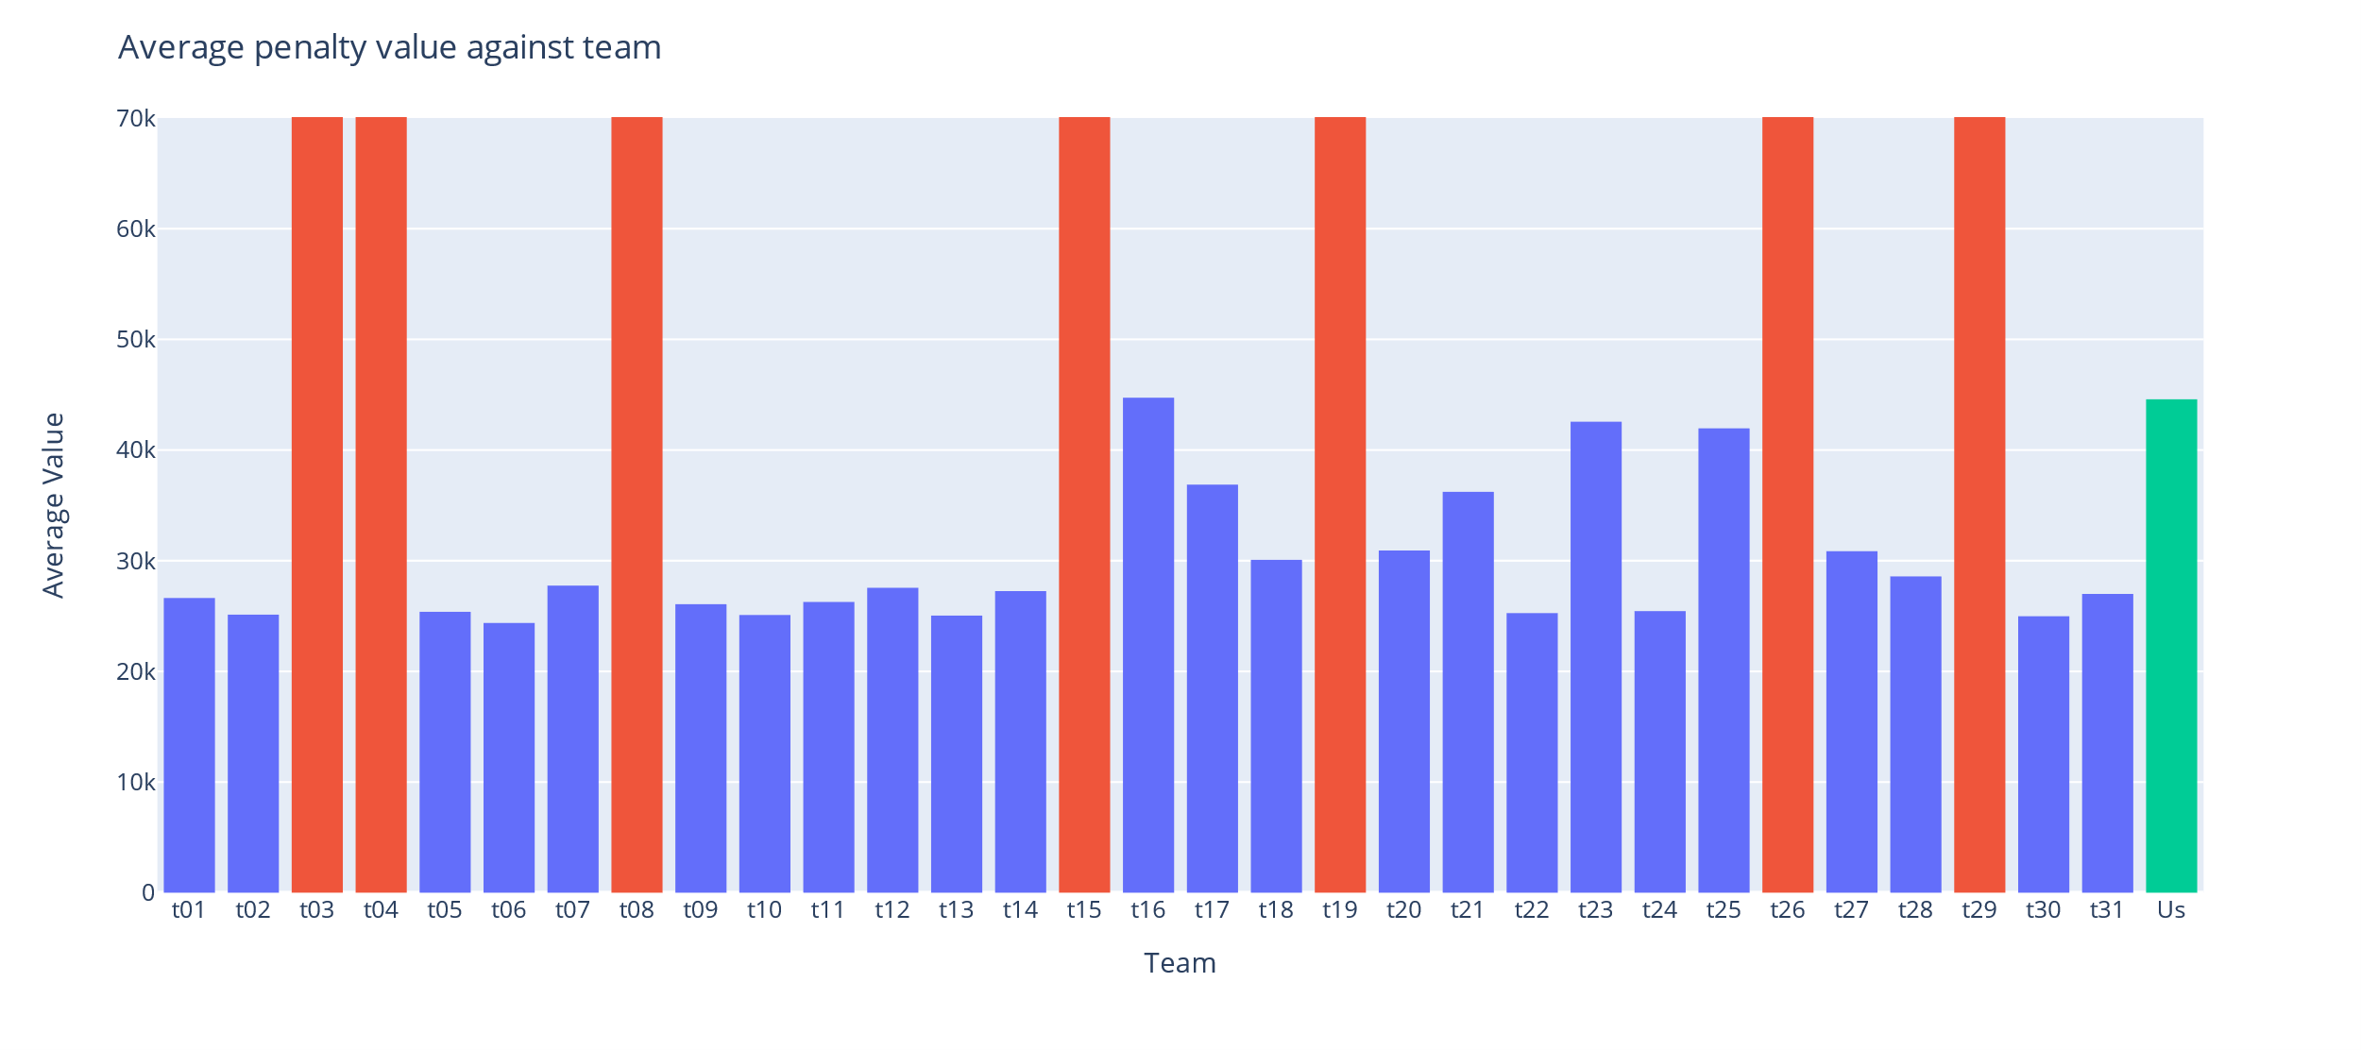
Comparison with other teams

Slide 18
Competition standing
Position in the competition overall
29th place out of 32 teams
Feasibility success
1 of 25 teams to submit a set of all feasible solutions
Open source and available to use
GitHub link: github.com/Mattmandav/IHTC2024

Slide 19
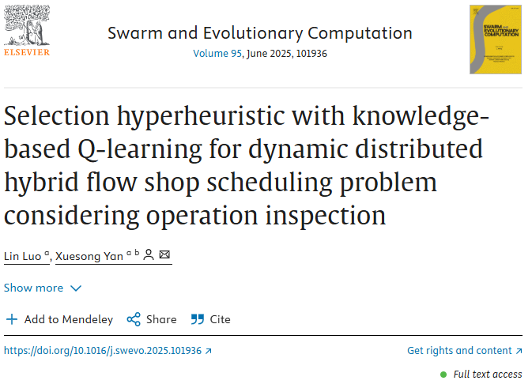
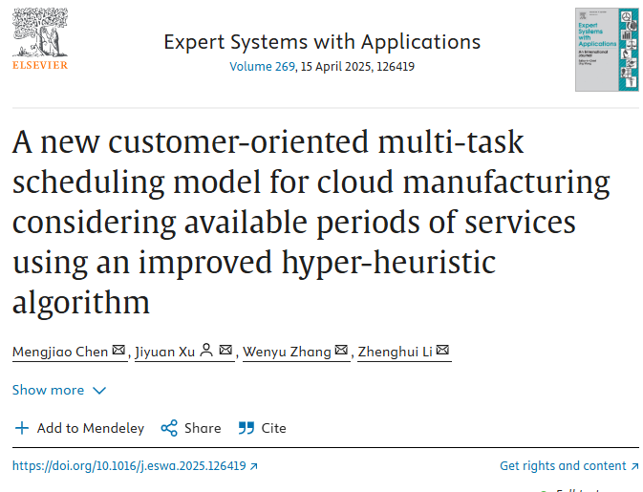
On the right track, but the wrong train…

Slide 20
Closing thoughts
Fun to participate
Challenging problem
Developed skills
Everyone brought something to table
Lessons learned
Can get good results in a short timespan
Will only get the best results when dedicating more time to project
Teamwork makes the dream work

Slide 21
Thank you for listening!
I will now take any questions

